Slide 1
Image Filtering
Running Median Filter
The running median filter is a variation of the standard median filter that is based on window overlapping.
It finds the local gray-level histogram of the pixels in each window and adapts it as the operation shifts to the next window.
In theory, it is much faster than the standard median filter.
For this exercise you are tasked to perform running median filtering on an image that has been corrupted by noise.

Slide 2
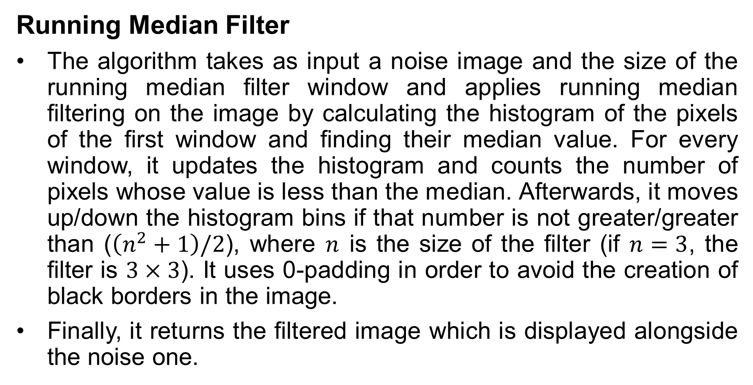
Image Filtering
Running Median Filter
The algorithm takes as input a noise image and the size of the running median filter window and applies running median filtering on the image by calculating the histogram of the pixels of the first window and finding their median value. For every window, it updates the histogram and counts the number of pixels whose value is less than the median. Afterwards, it moves up/down the histogram bins if that number is not greater/greater than ($\left(n^{2}+1\right)/2$), where $n$ is the size of the filter (if $n=3$, the filter is $3×3$). It uses 0-padding in order to avoid the creation of black borders in the image.
Finally, it returns the filtered image which is displayed alongside the noise one.

Slide 3

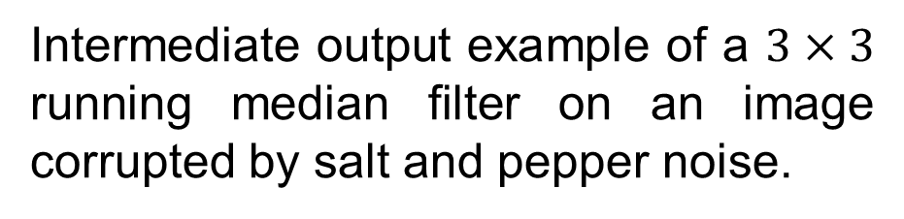
Image Filtering
Running Median Filter
Intermediate output example of a $3×3$ running median filter on an image corrupted by salt and pepper noise.
Input example

Slide 4
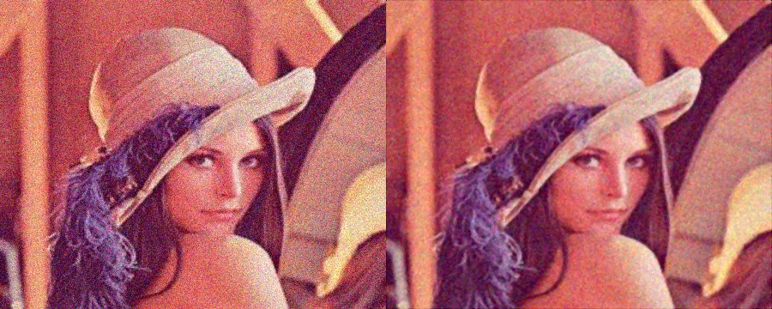
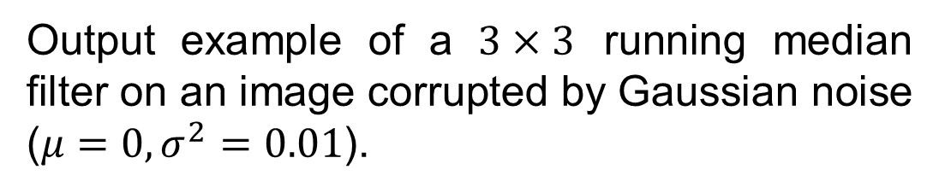
Image Filtering
Running Median Filter
Output example of a $3×3$ running median filter on an image corrupted by Gaussian noise ($μ=0, σ^{2}=0.01$).

